Slide 1

CSE 301 Random Variables
Atif Hasan Rahman
CSE, BUET

Slide 2
Random Variables
What are random variables?
Real-valued functions defined on the sample space
Frequently in experiments we are interested in some functions of the outcome as opposed to the outcome itself
For instance, in tossing dice we may be interested in the sum of the two dice and not the actual outcome
Since the value of a random variable is determined by the outcome of the experiment, we may assign probabilities to the possible values of the random variable

Slide 3
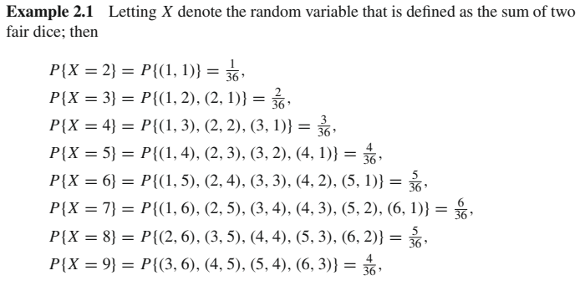
Random Variables

Slide 4
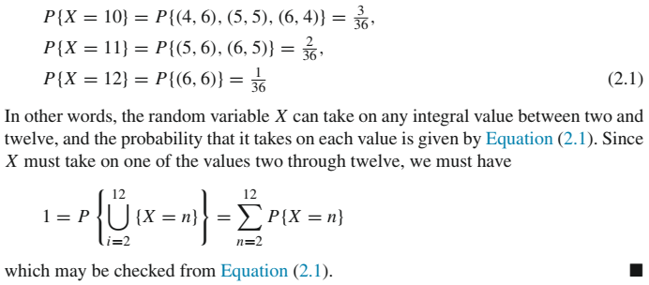
Random Variables

Slide 5
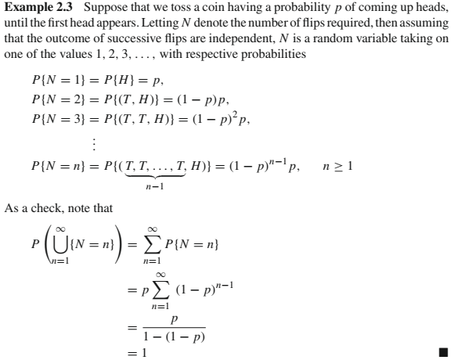

Slide 6
Discrete and Continuous RVs
Discrete random variables
Take on a finite or a countable number of possible values
Continuous random variables
Take on a continuum of possible values
For example
Random variable denoting the lifetime of a car
Can take on any value in some interval (a, b)

Slide 7
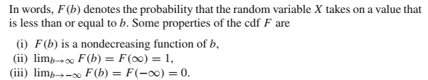
Cumulative distribution function (cdf)
The cumulative distribution function (cdf) (or distribution function)
F(·) of the random variable X is defined for any real number b, -∞ < b < ∞, by
F(b) = P{X ≤ b}

Slide 8
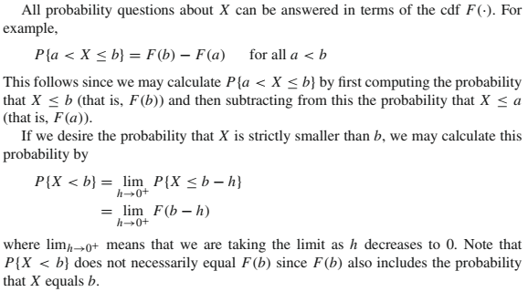
Cumulative distribution function (cdf)

Slide 9
Discrete Random Variables
A discrete random variable can take on at most a countable number of possible values
For a discrete random variable X, we define the probability mass function p(a) of X by p(a) = P{X = a}

Slide 10
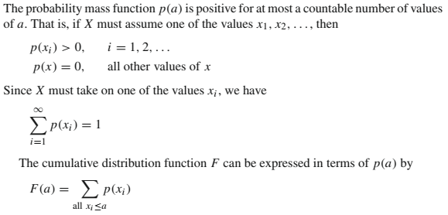
Discrete Random Variables

Slide 11
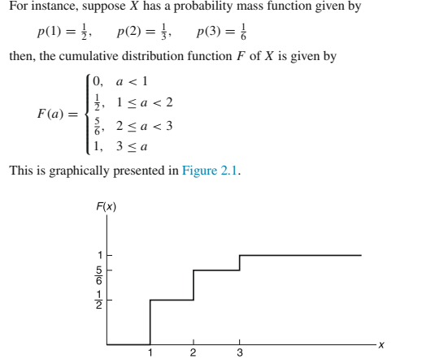
Discrete Random Variables

Slide 12
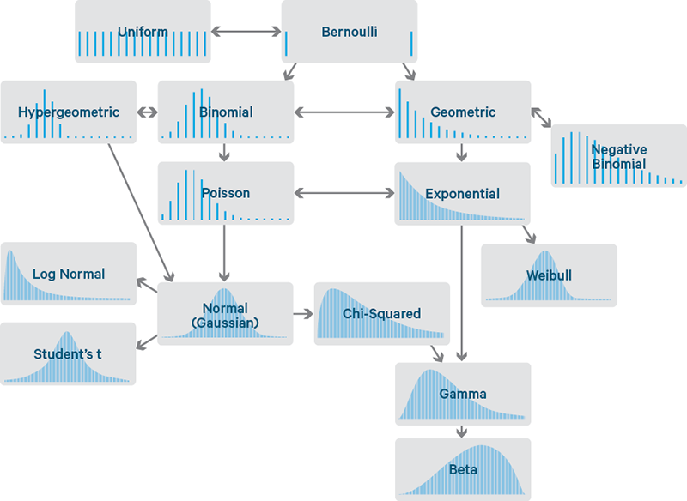
Common Probability Distributions
http://blog.cloudera.com/blog/2015/12/common-probability-distributions-the-data-scientists-crib-sheet

Slide 13
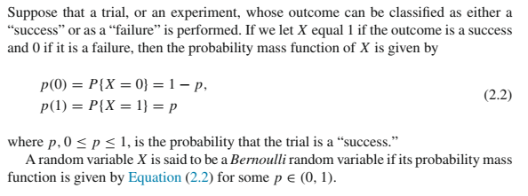
Bernoulli Random Variable

Slide 14
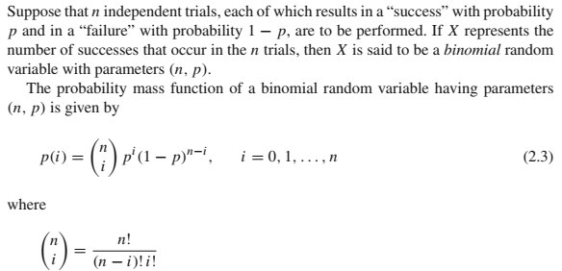
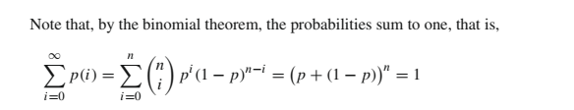
Binomial Random Variable

Slide 15
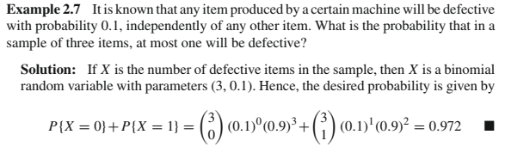
Binomial Random Variable

Slide 16
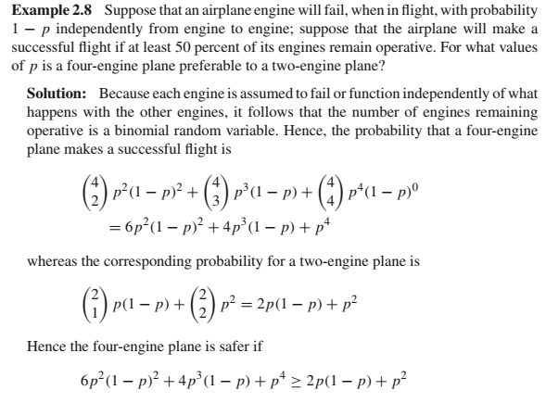
Binomial Random Variable

Slide 17
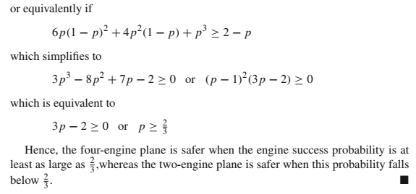
Binomial Random Variable

Slide 18
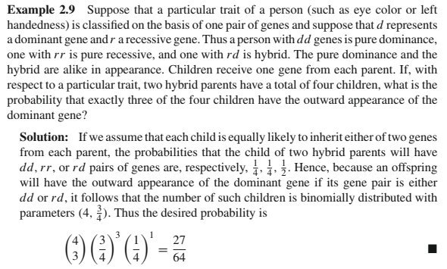
Binomial Random Variable

Slide 19
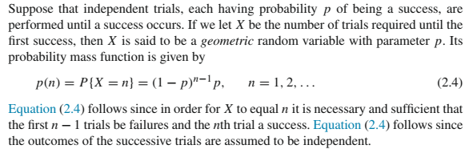
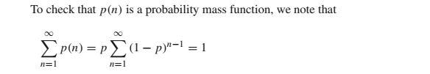
Geometric Random Variable

Slide 20
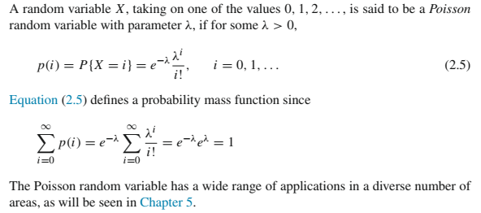
Poisson Random Variable

Slide 21

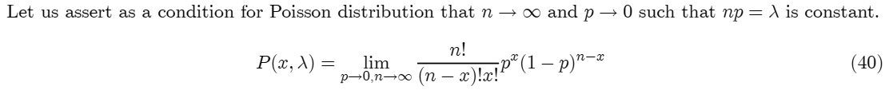
Poisson approximation of binomial
An important property of the Poisson random variable
May be used to approximate a binomial random variable when n is large and p is small

Slide 22
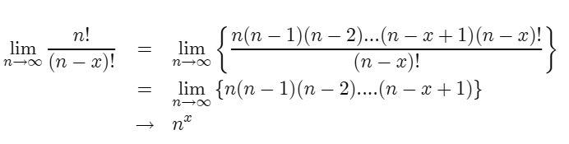

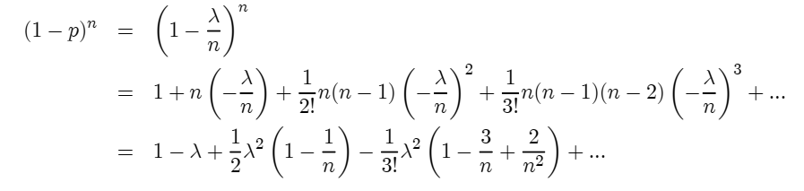
Poisson approximation of binomial
Now
Again

Slide 23


Poisson approximation of binomial
Therefore
i.e.
Hence

Slide 24
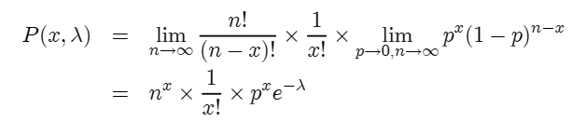

Poisson approximation of binomial
Putting things together
Since λ = np the Poisson distribution is given by

Slide 25


Poisson Random Variable

Slide 26
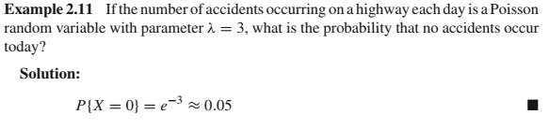
Poisson Random Variable

Slide 27


Continuous Random Variables
Random variables whose set of possible values is uncountable
X is a continuous random variable if there exists a nonnegative function f (x), defined for all real x ∈ (-∞, ∞), having the property that for any set B of real numbers
The function f (x) is called the probability density function of X
Since X must assume some value, f (x) must satisfy

Slide 28


Continuous Random Variables
All probability statements about X can be answered in terms of f (x). For instance, letting B = [a, b], we obtain
If we let a = b in the preceding, then

Slide 29


Continuous Random Variables
The relationship between the cumulative distribution F(·) and the probability density f (·) is expressed by
Differentiating both sides of the preceding yields
That is, the density is the derivative of the cumulative distribution function

Slide 30

Continuous Random Variables
A somewhat more intuitive interpretation of the density function may be obtained as follows:
when ε is small.
In other words, the probability that X will be contained in an interval of length ε around the point a is approximately εf (a).
From this, we see that f (a) is a measure of how likely it is that the random variable will be near a

Slide 31


Uniform Random Variable
A random variable is said to be uniformly distributed over the interval (0, 1) if its probability density function is given by
In general, we say that X is a uniform random variable on the interval (α, β) if its probability density function is given by

Slide 32


Exponential Random Variables
A continuous random variable whose probability density function is given, for some λ > 0, by
is said to be an exponential random variable with parameter λ
Related to the Poisson distribution. Later in Chapter 5
Cumulative distribution function F:

Slide 33



Gamma Random Variable
A continuous random variable whose density is given by
for some λ > 0, α > 0 is said to be a gamma random variable with parameters α, λ.
The gamma function and is defined by
For integral α, say, α = n,

Slide 34

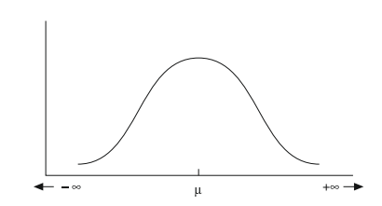
Normal (Gaussian) Random Variable
We say that X is a normal random variable (or simply that X is normally distributed) with parameters μ and σ² if the density of X is given by
Density function is a bell-shaped curve that is symmetric around μ

Slide 35


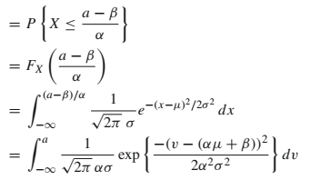
Normal (Gaussian) Random Variable
If X is normally distributed with parameters μ and σ² then Y = αX + β is normally distributed with parameters αμ + β and α²σ². Assuming α>0

Slide 36
Normal (Gaussian) Random Variable
One implication of the preceding result is that if X is normally distributed with parameters μ and σ²
Then Y = (X - μ)/σ is normally distributed with parameters 0 and 1
Such a random variable Y is said to have the standard or unit normal distribution

Slide 37
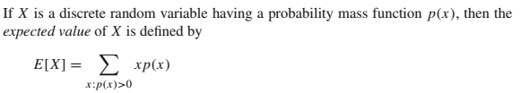
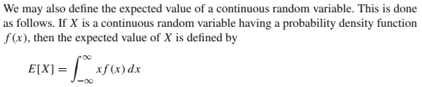
Expectation of a Random Variable
Discrete
Continuous

Slide 38
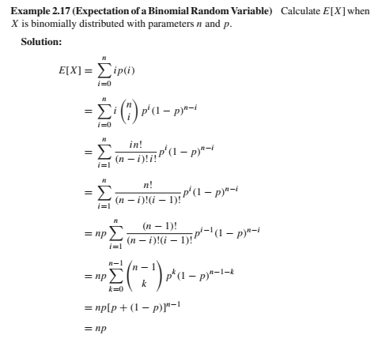
Expectation of a Random Variable

Slide 39
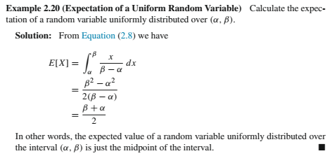
Expectation of a Random Variable

Slide 40
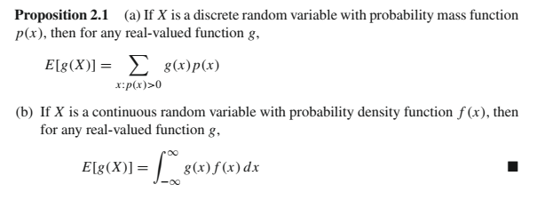
Expectation of a Function of a RV

Slide 41
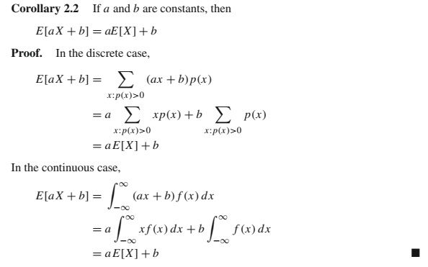
Expectation of a Function of a RV

Slide 42
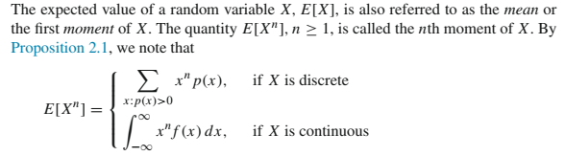
Moments of a Random Variable

Slide 43
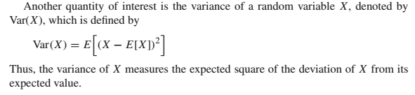
Variance of a Random Variable

Slide 44
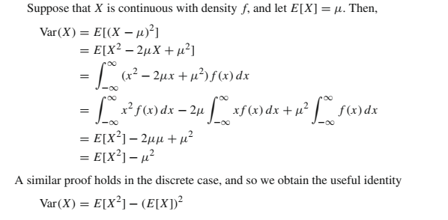
Variance of a Random Variable

Slide 45
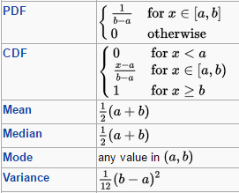
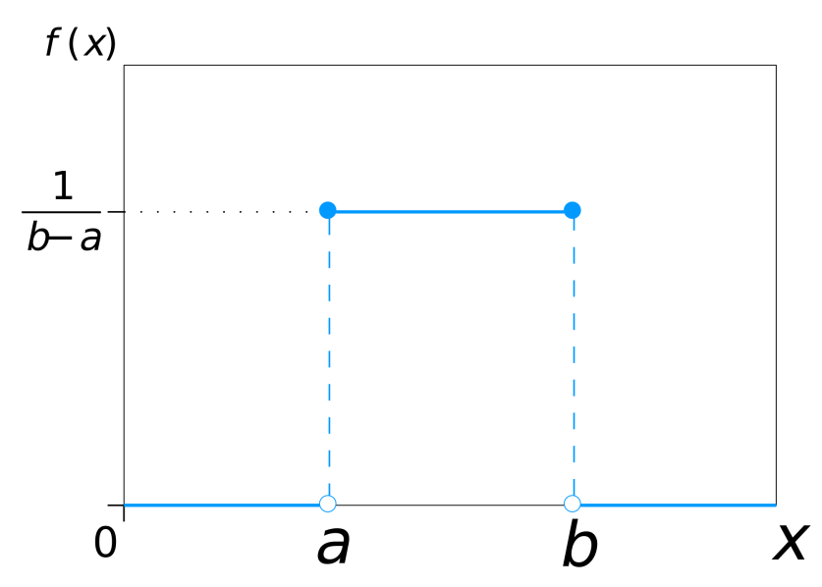
Uniform
Can be continuous or discrete
Parameterized by the interval
Continuous

Slide 46
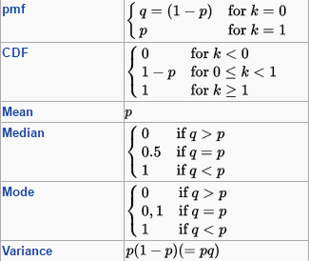
Bernoulli
Probability of success (1) or failure (0) in a single trial
Coin flip, rolling a die
Parameterized by the probability of success, p

Slide 47

Binomial
Probability of number of successes, k in n independent Bernoulli trials
The success probability p and number of trials n are the parameters
Past success/failures does not change p

Slide 48
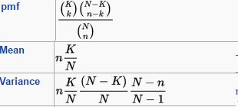
Hypergeometric
Also models probability of number of successes, k in n trials but without replacement
Probability of drawing aces from a deck of cards (once drawn cards are not put back into deck)
Parameters are n, population size, N and successes in population, K
Binomial is a good approximation when N, K large

Slide 49

Poisson
Probability of number of events, k occurring in a fixed interval of time and/or space
events occur with a known average rate and independently of the time since the last event
Parameterized using average number of events in an interval, λ

Slide 50
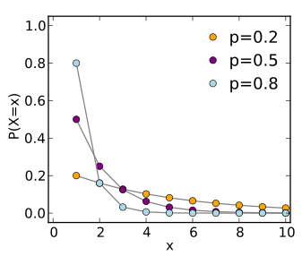
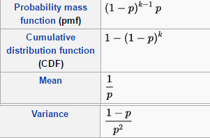
Geometric
Probability of number of trials, k till the first success
Each trial must be independent

Slide 51
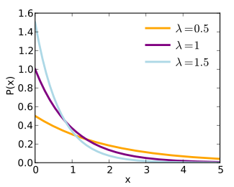
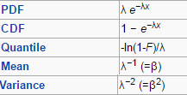
Exponential
Waiting time till an event occurs
Events need to occur with a constant average rate, λ and independently (memoryless)
Continuous analog of geometric

Slide 52
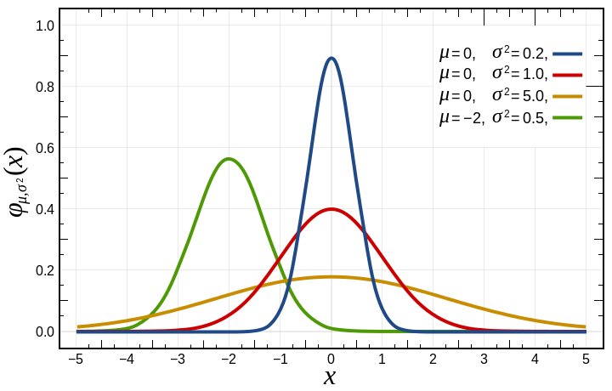
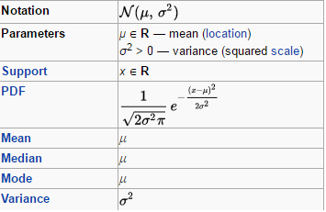
Gaussian (Normal)
Widely used bell shaped continuous distribution

